Slide 1

CAPSTONE PROJECT:
SEA
THE BATTLE OF THE NEIGHBORHOODS [SEATTLE]
Eric Frezell

Slide 2
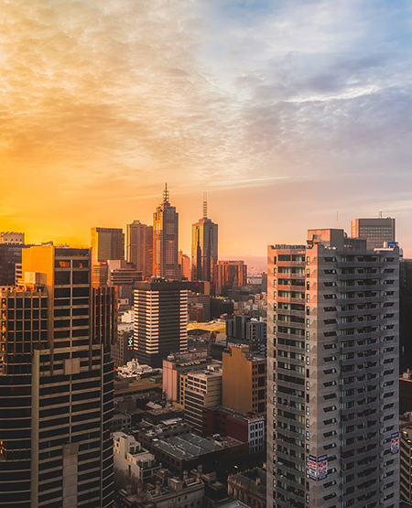
Introduction
Problem Defined
A close friend has planned to open a Japanese/Asian fusion
Location Musts:
Should not be close to similar restaurants
Must be in a wealthy neighborhood
Any neighborhoods in the greater Puget Sound area will suffice

Slide 3
Data Description
1.) Foursquare API
2.) Kaggle: Seattle Home Prices 2015
Venue Data:
Location
Restaurant Type
King County (Pudget Sound) Data:
Home price
Square foot of lot (appendix)
Number of bedrooms (appendix)
Other residential details

Slide 4
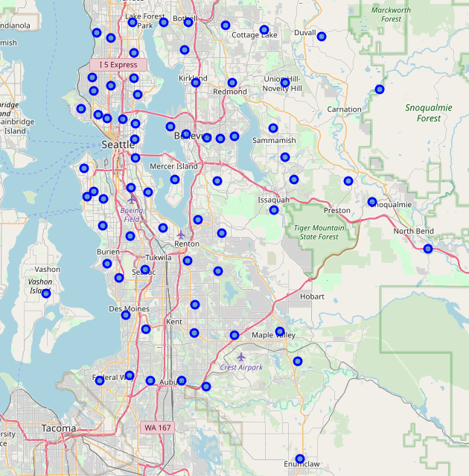
Methodology
Exploratory Data Analysis 1
Home price dataset contains over 20,000 unique home prices
Removed unnecessary columns
Aggregated the pricing data by zip code
Zip code 98039 ranks the highest on average for home price
Mapped each zip code to a marker and mapped the data points

Slide 5
Methodology
Exploratory Data Analysis 2
121 venues available within a 20 mile radius
42 rows missing either a zip code or category data
Remaining 79 venues
Data is selected, normalized and merged with the aggregated home prices
 | asian_restaurant | japanese_restaurant | mean_sqft_lot | mean_bedrooms | mean_price
0 | -0.118678 | -0.118678 | -0.204773 | 0.922207 | 1.014614
1 | -0.118678 | -0.118678 | -0.338588 | 0.464203 | 0.834057
2 | 8.426150 | 8.426150 | -0.189906 | 1.226810 | 2.093938

Slide 6
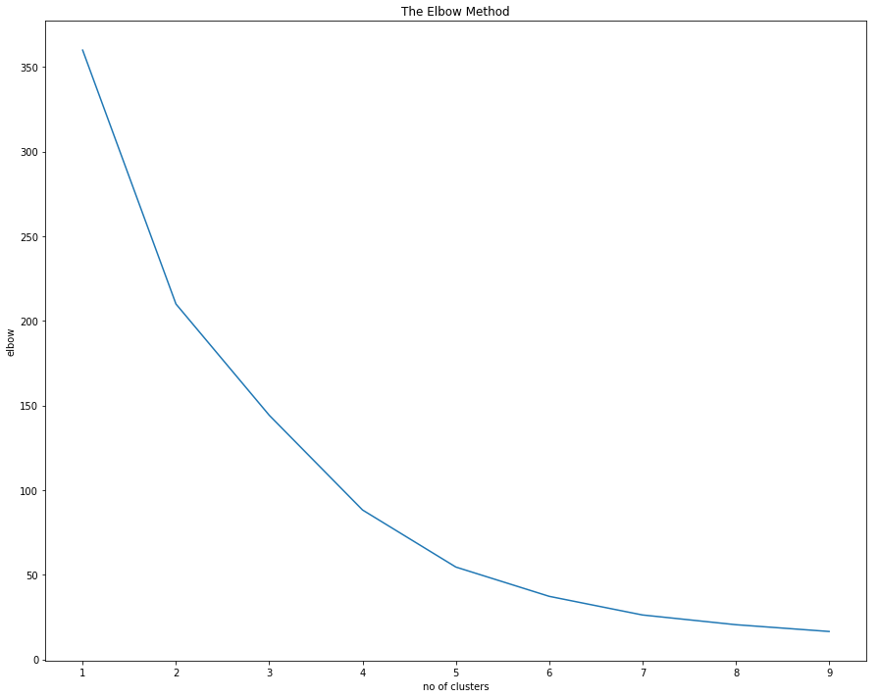
Methodology
Clustering
Experimented with several different numbers of clusters
Aligned on 6 clusters:
Best fit for the problem statement
low sum of squares error
K-means an efficient segmentation tool

Slide 7
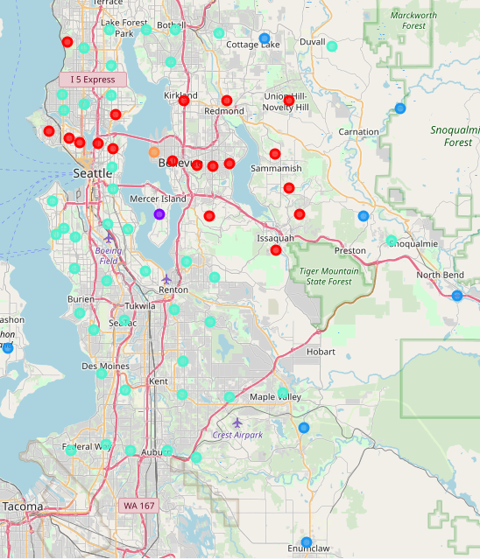
Results & Conclusion
Cluster Count: {0: 19, 1: 1, 2: 7, 3: 42, 4: 2, 5: 1}
Cluster 0: High home price
Cluster 1: Zip 98040 - available venue data
Cluster 2: Outskirt areas with median home price
Cluster 3: Low home price
Cluster 4: Insufficient venue and home price data
Cluster 5: Zip 98039 - wealthiest zip code RECOMMENDED!

